Slide 1
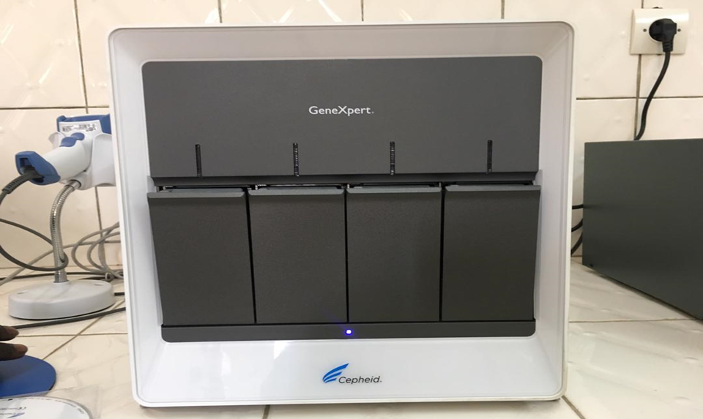
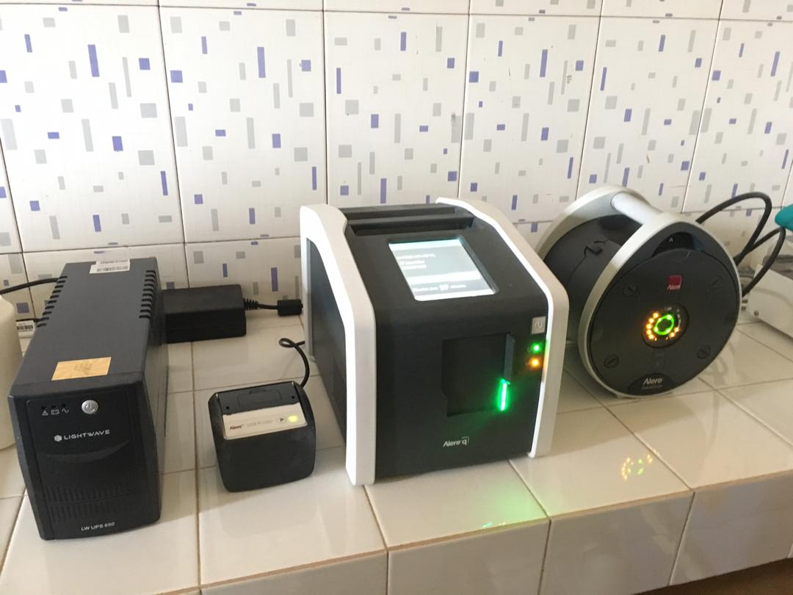
Decentralization of EID and VL testing in Senegal: Results from the Point-of-Care pilot
Coulibaly KD ¹, Ndiaye PM ¹, Dieye FL ¹, Sow A ², Séne PY ², Diallo S ², Ngom NF ⁴, Kiernan B ⁵, Mbaye RN ⁵, Diallo AN ⁶, Diop N ⁶, Diop K ¹, Ndiaye HD ², Kane C T ³, Ndour CT ¹
1 Division of AIDS and STI Control, 2 Laboratory of Bacteriology and Virology of A. Le Dantec, 3 Hospital Dalal Diam, IRESSEF, 4 UNICEF, 5 Clinton Health Access Initiative, 6 National Council for the Fight against AIDS
BACKGROUND
RESULTS
In 2018, only 49% of HIV exposed infants (HEI) in Senegal received an Early Infant Diagnosis (EID) and 23% of people living with HIV (PLHIV) on treatment received a Viral Load (VL) test
Centralized EID and VL testing in Dakar and at regional laboratories has meant long turnaround times for patients to get back their test results
In 2018 pre-POC, only 34% of EID tests and 68% of VL tests were processed. In 2019, this rate was over 90% post-POC
GENEXPERT RESULTS
There was no conventional testing data available in the 2018 pre-POC phase
32 EID tests and 422 VL POC tests conducted in the 2019 post-POC pilot
M-PIMA RESULTS
12 EID and 107 VL conventional tests conducted in the 2018 pre-POC phase
54 EID and 392 VL POC tests conducted in the 2019 post-POC pilot
n=422
100%
OBJECTIVES
 | GeneXpert EID | GeneXpert VL
Average time from sample collection to result return to patient | 1 day (1-2) | 1 day (1-1)
<1,000 cpm
To assess the influence of decentralizing EID and VL testing with Point-of-Care (POC) testing on result return and clinical decision making
>1000 cpm
VL results GeneXpert
 | Conventional EID testing | Conventional VL testing
Average time from sample collection to result return to patient | 107 days (107-107) | 317 days (310-321)
M-PIMA
100%
n=364
n=32
GeneXpert
METHODS
<1,000 cpm
Type of study: retrospective and prospective
Study site: 8 pilot sites
Study population: HEI aged 6 weeks or older and PLHIV who required a VL test for treatment monitoring
Data collection: Data were obtained from health facility registers and were collected using SurveyCTO
Time period: Three months of service data from 2018 and 2019 were compared before and after POC intervention
 | M-PIMA EID | M-PIMA VL
Average time from sample collection to result return to patient | 1 day (1-2) | 3 days (2-13)
>1000 cpm
VL HIV-1 m-PIMA results
VL HIV-2 m-PIMA results
CONCLUSION
The use of POCs at the decentralized level improves access to HIV diagnostics and turnaround time for EID and VL tests, thus allowing for better clinical management of patients
EID and VL test decentralization could be further improved with mentoring and support for healthcare workers to follow national guidelines and to strengthen health facility data
PRESENTED AT THE 23RD INTERNATIONAL AIDS CONFERENCE (AIDS 2020) | 6-10 JULY 2020

